Slide 1
Minimum Spanning Trees
wisnu ananta kusuma
ananta@apps.ipb.ac.id
Disarikan dari berbagai sumber

Slide 2
outline
Graph Terminology (some review)
Minimum Spanning Trees

Slide 3
Graph
Terminology

Slide 4
Paths and cycles
A path is a sequence of nodes v₁, v₂, …, v_{N} such that (v_{i},v_{i+1})∈E for 0<i<N
The length of the path is N-1.
Simple path: all v_{i} are distinct, 0<i<N
A cycle is a path such that v₁=v_{N}
An acyclic graph has no cycles

Slide 5
More useful definitions
In a directed graph:
The indegree of a node v is the number of distinct edges (w,v)∈E.
The outdegree of a node v is the number of distinct edges (v,w)∈E.
A node with indegree 0 is a root.

Slide 6
Trees are graphs
A dag is a directed acyclic graph.
A tree is a connected acyclic undirected graph.
A forest is an acyclic undirected graph (not necessarily connected), i.e., each connected component is a tree.

Slide 7
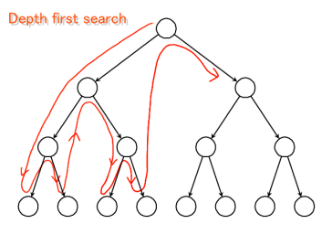
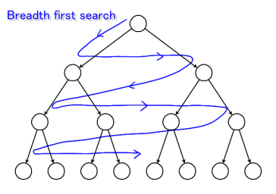
Graph Traversals
Both take time: O(V+E)

Slide 8
Minimum Spanning Trees

Slide 9
Problem: Laying Telephone Wire
Central office

Slide 10
Wiring: Naïve Approach
Central office
Expensive!

Slide 11
Writing: better approach
Central office
Minimize the total length of wire connecting the customers

Slide 12
What is spanning tree?
A spanning tree for an undirected graph G=(V,E) is a subgraph of G that is a tree and contains all the vertices of G
Can a graph have more than one spanning tree?
Can an unconnected graph have a spanning tree?

Slide 13
What is spanning tree?
A spanning tree is a subset of Graph G, which has all the vertices covered with minimum possible number of edges.
Hence, a spanning tree does not have cycles and it cannot be disconnected
By this definition, we can draw a conclusion that every connected and undirected Graph G has at least one spanning tree.
A disconnected graph does not have any spanning tree, as it cannot be spanned to all its vertices.

Slide 14
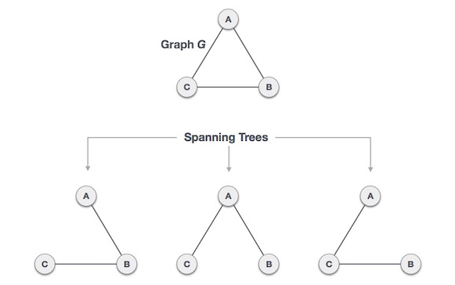

Slide 15
General properties
minimally connected.
maximally acyclic.

Slide 16
Mathematical properties
Spanning tree has n-1 edges, where n is the number of nodes (vertices).
From a complete graph, by removing maximum e - n + 1 edges, we can construct a spanning tree.
A complete graph can have maximum n^{n-2} number of spanning trees.

Slide 17
What is minimum spanning tree
In a weighted graph, a minimum spanning tree is a spanning tree that has minimum weight than all other spanning trees of the same graph.
In real-world situations, this weight can be measured as distance, congestion, traffic load or any arbitrary value denoted to the edges.

Slide 18
Algorithm Characteristics
Both Prim’s and Kruskal’s Algorithms work with undirected graphs
Both work with weighted and unweighted graphs but are more interesting when edges are weighted
Both are greedy algorithms that produce optimal solutions

Slide 19
Pada masalah MST, sedikitnya dapat
digunakan 2 macam solusi parsial dalam
perancangan algoritma greedy:
Jika solusi parsial adalah forest dalam graf, maka algoritma yang terbentuk adalah algoritma Kruskal
2. Jika solusi parsial adalah tree dalam graf, maka algoritma yang terbentuk adalah algoritma Prim
Bagaimana cara kerja kedua algoritma ?

Slide 20
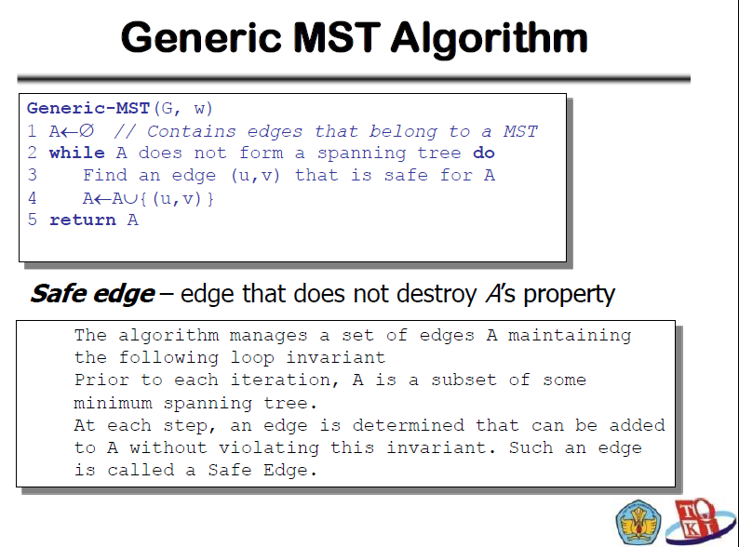

Slide 21
Kruskal’s Algorithm
Walk-Through
Consider an undirected, weight graph
F
3
C
10
A
4
3
8
4
5
B
6
D
4
4
H
2
1
3
G
E
3

Slide 22
Sort the edges by non-dereasing edge weight
F
3
C
edge | d_{v}
(D,E) | 1
(D,G) | 2
(E,G) | 3
(C,D) | 3
(G,H) | 3
(C,F) | 3
(B,C) | 4
edge | d_{v}
(B,E) | 4
(B,F) | 4
(B,H) | 4
(A,H) | 5
(D,F) | 6
(A,B) | 8
(A,F) | 10
10
A
4
3
8
4
5
B
6
D
4
4
H
2
1
3
G
E
3

Slide 23
Select first |V|–1 edges which do not generate a cycle
F
3
C
edge | d_{v}
(D,E) | 1 | √
(D,G) | 2
(E,G) | 3
(C,D) | 3
(G,H) | 3
(C,F) | 3
(B,C) | 4
edge | d_{v}
(B,E) | 4
(B,F) | 4
(B,H) | 4
(A,H) | 5
(D,F) | 6
(A,B) | 8
(A,F) | 10
10
A
4
3
8
4
5
B
6
D
4
4
H
2
1
3
G
E
3

Slide 24
Select first |V|–1 edges which do not generate a cycle
F
3
C
edge | d_{v}
(D,E) | 1 | √
(D,G) | 2 | √
(E,G) | 3
(C,D) | 3
(G,H) | 3
(C,F) | 3
(B,C) | 4
edge | d_{v}
(B,E) | 4
(B,F) | 4
(B,H) | 4
(A,H) | 5
(D,F) | 6
(A,B) | 8
(A,F) | 10
10
A
4
3
8
4
5
B
6
D
4
4
H
2
1
3
G
E
3

Slide 25
Select first |V|–1 edges which do not generate a cycle
F
3
C
edge | d_{v}
(D,E) | 1 | √
(D,G) | 2 | √
(E,G) | 3 | χ
(C,D) | 3
(G,H) | 3
(C,F) | 3
(B,C) | 4
edge | d_{v}
(B,E) | 4
(B,F) | 4
(B,H) | 4
(A,H) | 5
(D,F) | 6
(A,B) | 8
(A,F) | 10
10
A
4
3
8
4
5
B
6
D
4
4
H
2
1
3
G
E
3
Accepting edge (E,G) would create a cycle

Slide 26
Select first |V|–1 edges which do not generate a cycle
F
3
C
edge | d_{v}
(D,E) | 1 | √
(D,G) | 2 | √
(E,G) | 3 | χ
(C,D) | 3 | √
(G,H) | 3
(C,F) | 3
(B,C) | 4
edge | d_{v}
(B,E) | 4
(B,F) | 4
(B,H) | 4
(A,H) | 5
(D,F) | 6
(A,B) | 8
(A,F) | 10
10
A
4
3
8
4
5
B
6
D
4
4
H
2
1
3
G
E
3

Slide 27
Select first |V|–1 edges which do not generate a cycle
F
3
C
edge | d_{v}
(D,E) | 1 | √
(D,G) | 2 | √
(E,G) | 3 | χ
(C,D) | 3 | √
(G,H) | 3 | √
(C,F) | 3
(B,C) | 4
edge | d_{v}
(B,E) | 4
(B,F) | 4
(B,H) | 4
(A,H) | 5
(D,F) | 6
(A,B) | 8
(A,F) | 10
10
A
4
3
8
4
5
B
6
D
4
4
H
2
1
3
G
E
3

Slide 28
Select first |V|–1 edges which do not generate a cycle
F
3
C
edge | d_{v}
(D,E) | 1 | √
(D,G) | 2 | √
(E,G) | 3 | χ
(C,D) | 3 | √
(G,H) | 3 | √
(C,F) | 3 | √
(B,C) | 4
edge | d_{v}
(B,E) | 4
(B,F) | 4
(B,H) | 4
(A,H) | 5
(D,F) | 6
(A,B) | 8
(A,F) | 10
10
A
4
3
8
4
5
B
6
D
4
4
H
2
1
3
G
E
3

Slide 29
Select first |V|–1 edges which do not generate a cycle
F
3
C
edge | d_{v}
(D,E) | 1 | √
(D,G) | 2 | √
(E,G) | 3 | χ
(C,D) | 3 | √
(G,H) | 3 | √
(C,F) | 3 | √
(B,C) | 4 | √
edge | d_{v}
(B,E) | 4
(B,F) | 4
(B,H) | 4
(A,H) | 5
(D,F) | 6
(A,B) | 8
(A,F) | 10
10
A
4
3
8
4
5
B
6
D
4
4
H
2
1
3
G
E
3

Slide 30
Select first |V|–1 edges which do not generate a cycle
F
3
C
edge | d_{v}
(D,E) | 1 | √
(D,G) | 2 | √
(E,G) | 3 | χ
(C,D) | 3 | √
(G,H) | 3 | √
(C,F) | 3 | √
(B,C) | 4 | √
edge | d_{v}
(B,E) | 4 | χ
(B,F) | 4
(B,H) | 4
(A,H) | 5
(D,F) | 6
(A,B) | 8
(A,F) | 10
10
A
4
3
8
4
5
B
6
D
4
4
H
2
1
3
G
E
3

Slide 31
Select first |V|–1 edges which do not generate a cycle
F
3
C
edge | d_{v}
(D,E) | 1 | √
(D,G) | 2 | √
(E,G) | 3 | χ
(C,D) | 3 | √
(G,H) | 3 | √
(C,F) | 3 | √
(B,C) | 4 | √
edge | d_{v}
(B,E) | 4 | χ
(B,F) | 4 | χ
(B,H) | 4
(A,H) | 5
(D,F) | 6
(A,B) | 8
(A,F) | 10
10
A
4
3
8
4
5
B
6
D
4
4
H
2
1
3
G
E
3

Slide 32
Select first |V|–1 edges which do not generate a cycle
F
3
C
edge | d_{v}
(D,E) | 1 | √
(D,G) | 2 | √
(E,G) | 3 | χ
(C,D) | 3 | √
(G,H) | 3 | √
(C,F) | 3 | √
(B,C) | 4 | √
edge | d_{v}
(B,E) | 4 | χ
(B,F) | 4 | χ
(B,H) | 4 | χ
(A,H) | 5
(D,F) | 6
(A,B) | 8
(A,F) | 10
10
A
4
3
8
4
5
B
6
D
4
4
H
2
1
3
G
E
3

Slide 33
Select first |V|–1 edges which do not generate a cycle
F
3
C
edge | d_{v}
(D,E) | 1 | √
(D,G) | 2 | √
(E,G) | 3 | χ
(C,D) | 3 | √
(G,H) | 3 | √
(C,F) | 3 | √
(B,C) | 4 | √
edge | d_{v}
(B,E) | 4 | χ
(B,F) | 4 | χ
(B,H) | 4 | χ
(A,H) | 5 | √
(D,F) | 6
(A,B) | 8
(A,F) | 10
10
A
4
3
8
4
5
B
6
D
4
4
H
2
1
3
G
E
3

Slide 34
Select first |V|–1 edges which do not generate a cycle
F
3
C
edge | d_{v}
(D,E) | 1 | √
(D,G) | 2 | √
(E,G) | 3 | χ
(C,D) | 3 | √
(G,H) | 3 | √
(C,F) | 3 | √
(B,C) | 4 | √
edge | d_{v}
(B,E) | 4 | χ
(B,F) | 4 | χ
(B,H) | 4 | χ
(A,H) | 5 | √
(D,F) | 6
(A,B) | 8
(A,F) | 10
A
3
4
5
B
D
H
2
1
}
3
G
E
not
considered
Done
Total Cost = Σ d_{v} = 21

Slide 35
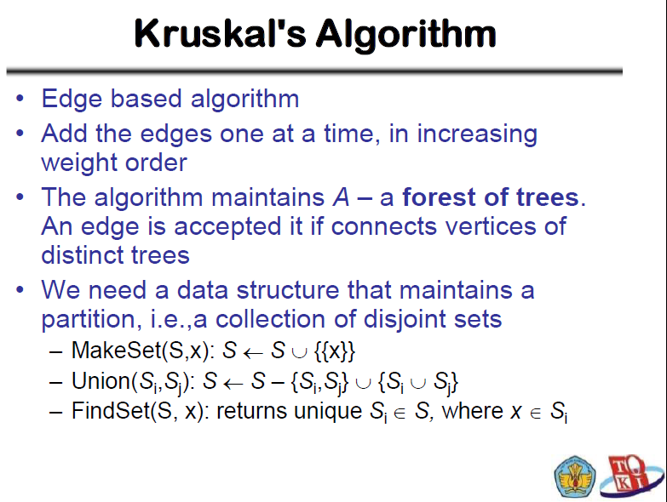

Slide 36
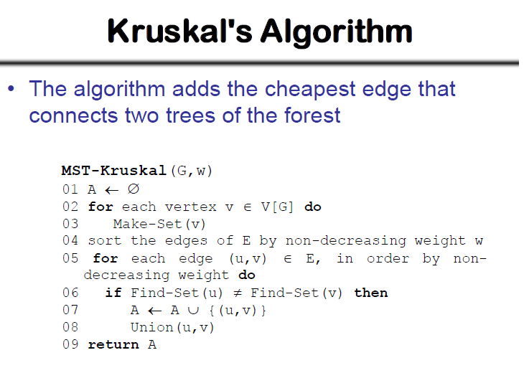

Slide 37
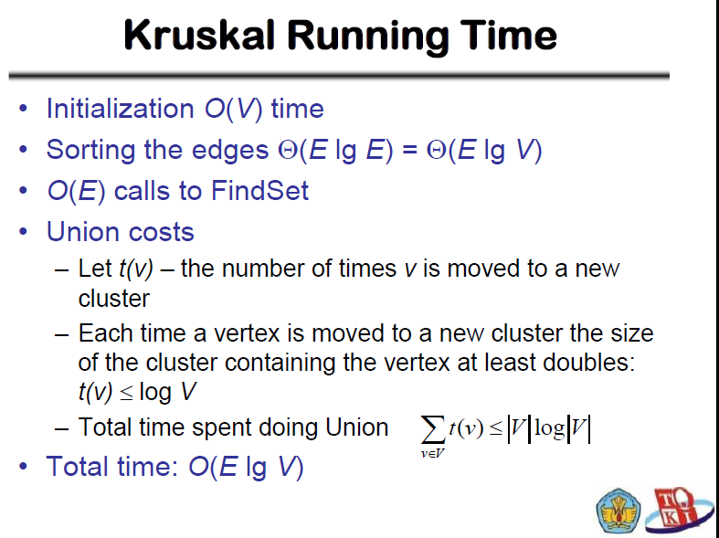

Slide 38
Walk-Through
Prim Algorithm
2
Initialize array
F
3
C
 | K | d_{v} | p_{v}
A | F | ∞ | −
B | F | ∞ | −
C | F | ∞ | −
D | F | ∞ | −
E | F | ∞ | −
F | F | ∞ | −
G | F | ∞ | −
H | F | ∞ | −
10
A
7
3
8
4
4
B
18
D
9
10
H
2
25
3
G
E
7

Slide 39
2
Start with any node, say D
F
3
C
 | K | d_{v} | p_{v}
A
B
C
D | T | 0 | −
E
F
G
H
10
A
7
3
8
4
4
B
18
D
9
10
H
2
25
3
G
E
7

Slide 40
2
Update distances of adjacent, unselected nodes
F
3
C
 | K | d_{v} | p_{v}
A
B
C |  | 3 | D
D | T | 0 | −
E |  | 25 | D
F |  | 18 | D
G |  | 2 | D
H
10
A
7
3
8
4
4
B
18
D
9
10
H
2
25
3
G
E
7

Slide 41
2
Select node with minimum distance
F
3
C
 | K | d_{v} | p_{v}
A
B
C |  | 3 | D
D | T | 0 | −
E |  | 25 | D
F |  | 18 | D
G | T | 2 | D
H
10
A
7
3
8
4
4
B
18
D
9
10
H
2
25
3
G
E
7

Slide 42
2
Update distances of adjacent, unselected nodes
F
3
C
 | K | d_{v} | p_{v}
A
B
C |  | 3 | D
D | T | 0 | −
E |  | 7 | G
F |  | 18 | D
G | T | 2 | D
H |  | 3 | G
10
A
7
3
8
4
4
B
18
D
9
10
H
2
25
3
G
E
7

Slide 43
2
Select node with minimum distance
F
3
C
 | K | d_{v} | p_{v}
A
B
C | T | 3 | D
D | T | 0 | −
E |  | 7 | G
F |  | 18 | D
G | T | 2 | D
H |  | 3 | G
10
A
7
3
8
4
4
B
18
D
9
10
H
2
25
3
G
E
7

Slide 44
2
Update distances of adjacent, unselected nodes
F
3
C
 | K | d_{v} | p_{v}
A
B |  | 4 | C
C | T | 3 | D
D | T | 0 | −
E |  | 7 | G
F |  | 3 | C
G | T | 2 | D
H |  | 3 | G
10
A
7
3
8
4
4
B
18
D
9
10
H
2
25
3
G
E
7

Slide 45
2
Select node with minimum distance
F
3
C
 | K | d_{v} | p_{v}
A
B |  | 4 | C
C | T | 3 | D
D | T | 0 | −
E |  | 7 | G
F | T | 3 | C
G | T | 2 | D
H |  | 3 | G
10
A
7
3
8
4
4
B
18
D
9
10
H
2
25
3
G
E
7

Slide 46
2
Update distances of adjacent, unselected nodes
F
3
C
 | K | d_{v} | p_{v}
A |  | 10 | F
B |  | 4 | C
C | T | 3 | D
D | T | 0 | −
E |  | 2 | F
F | T | 3 | C
G | T | 2 | D
H |  | 3 | G
10
A
7
3
8
4
4
B
18
D
9
10
H
2
25
3
G
E
7

Slide 47
2
Select node with minimum distance
F
3
C
 | K | d_{v} | p_{v}
A |  | 10 | F
B |  | 4 | C
C | T | 3 | D
D | T | 0 | −
E | T | 2 | F
F | T | 3 | C
G | T | 2 | D
H |  | 3 | G
10
A
7
3
8
4
4
B
18
D
9
10
H
2
25
3
G
E
7

Slide 48
2
Update distances of adjacent, unselected nodes
F
3
C
 | K | d_{v} | p_{v}
A |  | 10 | F
B |  | 4 | C
C | T | 3 | D
D | T | 0 | −
E | T | 2 | F
F | T | 3 | C
G | T | 2 | D
H |  | 3 | G
10
A
7
3
8
4
4
B
18
D
9
10
H
2
25
3
G
E
7
Table entries unchanged

Slide 49
2
Select node with minimum distance
F
3
C
 | K | d_{v} | p_{v}
A |  | 10 | F
B |  | 4 | C
C | T | 3 | D
D | T | 0 | −
E | T | 2 | F
F | T | 3 | C
G | T | 2 | D
H | T | 3 | G
10
A
7
3
8
4
4
B
18
D
9
10
H
2
25
3
G
E
7

Slide 50
2
Update distances of adjacent, unselected nodes
F
3
C
 | K | d_{v} | p_{v}
A |  | 4 | H
B |  | 4 | C
C | T | 3 | D
D | T | 0 | −
E | T | 2 | F
F | T | 3 | C
G | T | 2 | D
H | T | 3 | G
10
A
7
3
8
4
4
B
18
D
9
10
H
2
25
3
G
E
7

Slide 51
2
Select node with minimum distance
F
3
C
 | K | d_{v} | p_{v}
A | T | 4 | H
B |  | 4 | C
C | T | 3 | D
D | T | 0 | −
E | T | 2 | F
F | T | 3 | C
G | T | 2 | D
H | T | 3 | G
10
A
7
3
8
4
4
B
18
D
9
10
H
2
25
3
G
E
7

Slide 52
2
Update distances of adjacent, unselected nodes
F
3
C
 | K | d_{v} | p_{v}
A | T | 4 | H
B |  | 4 | C
C | T | 3 | D
D | T | 0 | −
E | T | 2 | F
F | T | 3 | C
G | T | 2 | D
H | T | 3 | G
10
A
7
3
8
4
4
B
18
D
9
10
H
2
25
3
G
E
7
Table entries unchanged

Slide 53
2
Select node with minimum distance
F
3
C
 | K | d_{v} | p_{v}
A | T | 4 | H
B | T | 4 | C
C | T | 3 | D
D | T | 0 | −
E | T | 2 | F
F | T | 3 | C
G | T | 2 | D
H | T | 3 | G
10
A
7
3
8
4
4
B
18
D
9
10
H
2
25
3
G
E
7

Slide 54
2
Cost of Minimum Spanning Tree = Σ d_{v} = 21
F
3
C
 | K | d_{v} | p_{v}
A | T | 4 | H
B | T | 4 | C
C | T | 3 | D
D | T | 0 | −
E | T | 2 | F
F | T | 3 | C
G | T | 2 | D
H | T | 3 | G
A
3
4
4
B
D
H
2
3
G
E
Done

Slide 55
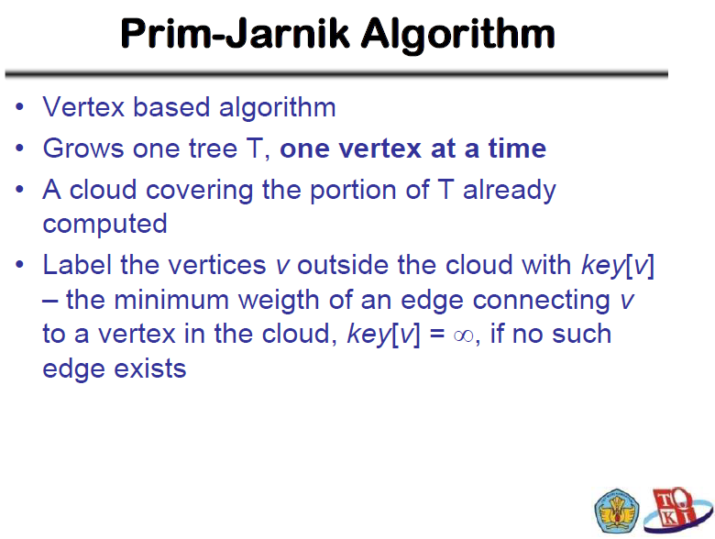

Slide 56


Slide 57
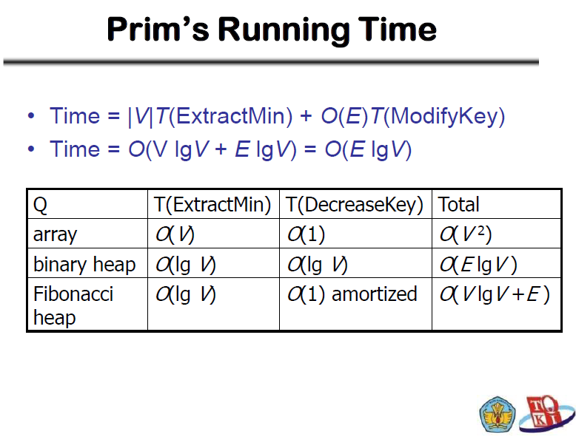

Slide 58
Contoh :
Tentukan MST bila diberikan graf berikut:
Contoh :
Tentukan MST bila diberikan graf berikut:
1
6
18
3
9
17
15
5
2
16
8
11
12
7
10
4

Slide 59
Aplikasi Minimum Spanning Tree dalam dunia nyata
Perancangan jaringan perpipaan yang efisien
Telekomunikasi
Disain rute yang efisien dalam transportasi
Analisis gen-gen yang berpengaruh pada suatu fenotipe
dll

Slide 60


